Slide 1
Canadian Bat Phenology
BIS 15L Winter Group 7
By: Darius Arasteh, Wenliang Weng, and Zirui(Andrew) Zheng

Slide 2
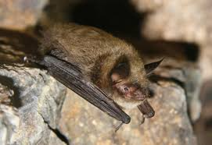
Background & Explorations
Data Explorations:
1. Site (Types) & Activities
How does bat acoustic activity change across the season?
Which sites have the highest total activity?
2. Reproductive Status
When are the timings of key reproductive events?
3. Morphology & Spatial Interpretations
Investigate Mass & Forearm & Ear associations with Regions and Seasons
Myotis Lucifugus (Little Brown Bat)
Notes:
Remember to mention that they are from the Northern Hemisphere.

Slide 3
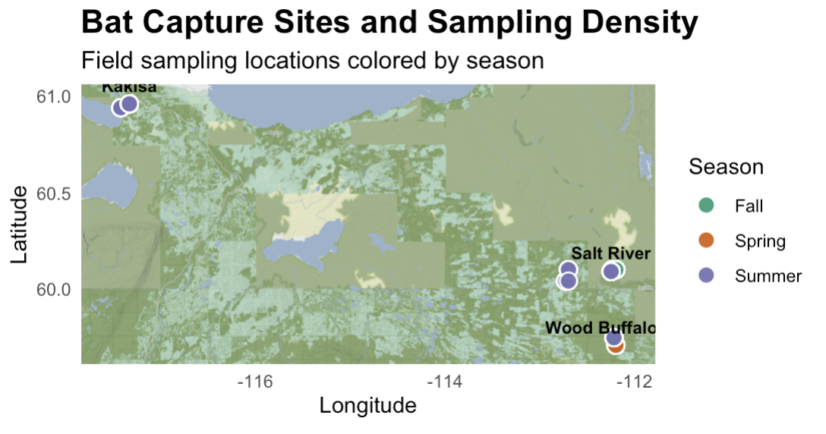
Canada
Notes:
North Latitiude

Slide 4
Dataset Intro
1. Myotis Acoustic Dataset – Bat Activities
Ultrasonic Sensor data from 5 sites filtered to isolate Myotis calls. (Exploration 1)
2. Myotis Capture Dataset – Biological & Demographic Data
Records of individual bats captured during emergence, analyzed for health, reproductive status, and dimensions, and tagged for future ID. (Exploration 2 & 3.)

Slide 5
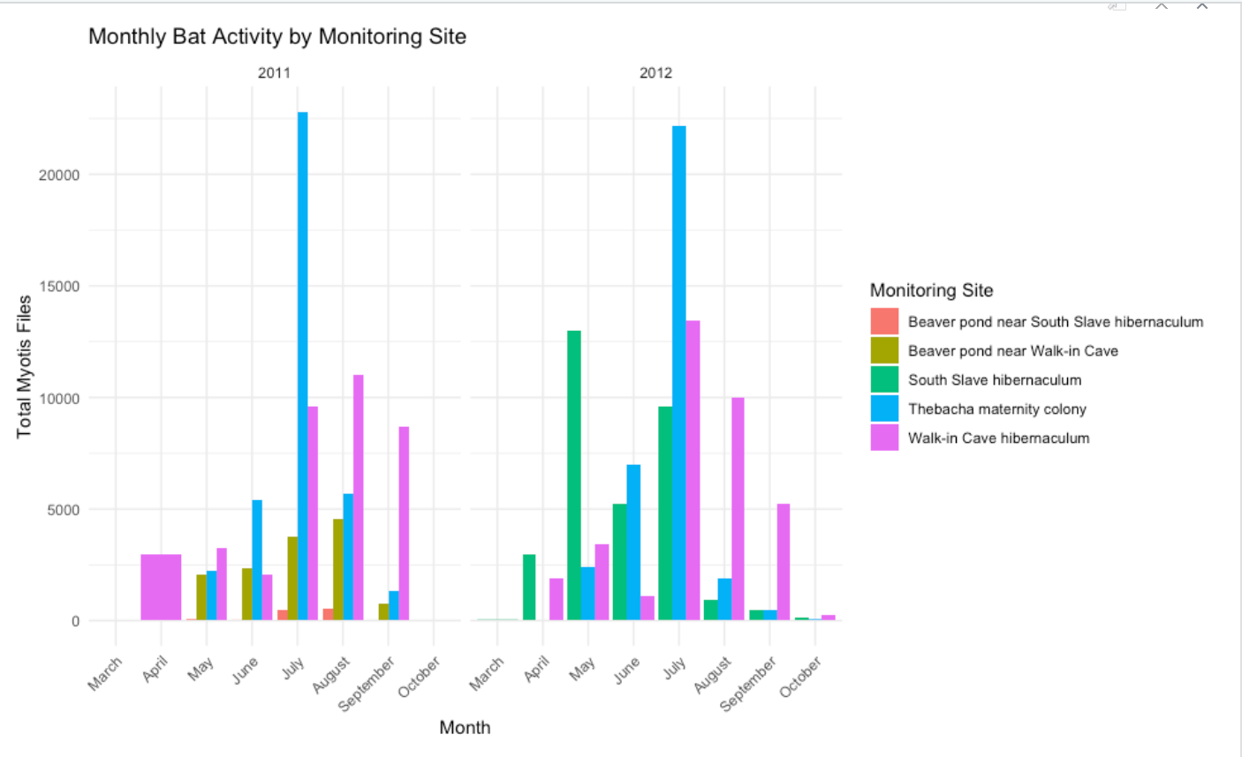
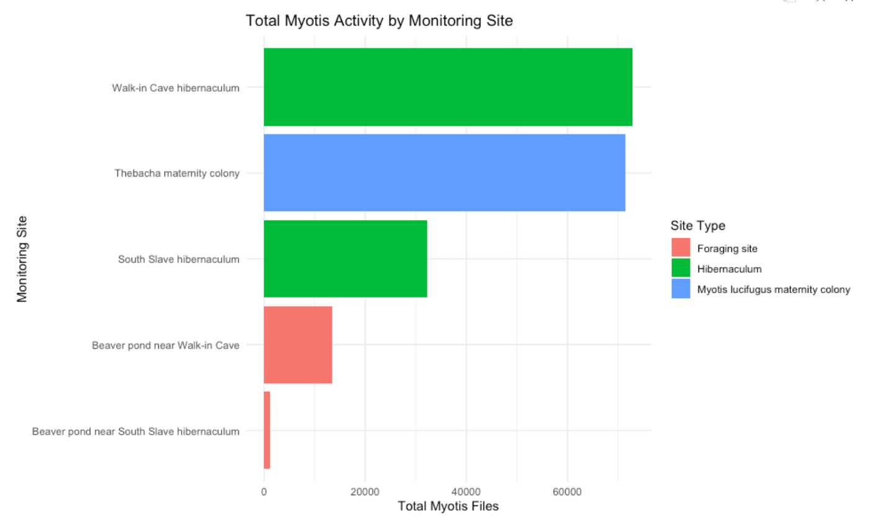
1. Site (Types) & Activities
Notes:
Hi everyone! Our project looks at little brown bats using acoustic data, which means recordings from bat detectors that pick up bat calls at night. In our dataset, Myotis detections are basically a count of how many bat call events were recorded, so higher detections usually mean more bat activity.
We made two graphs. Graph 1 shows total bat activity by month, which helps answer: “When is activity highest across the season?” Graph 2 compares total activity across **habitat types, which helps answer: “Which habitats have the most activity?”

Slide 6
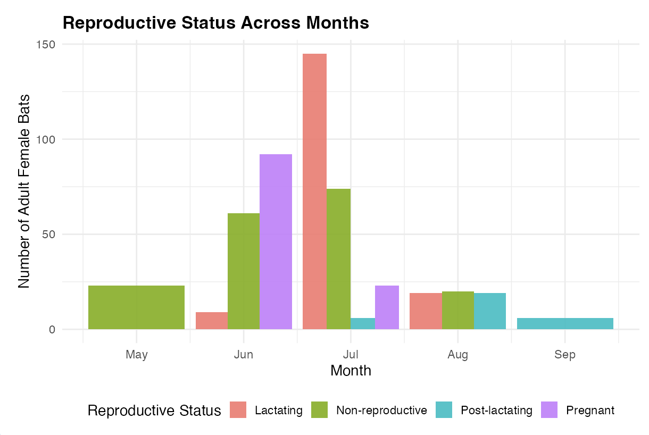
2. Reproductive Status and Timing
Notes:
June - Pregnant; July - Lactating; Aug – Post-lactating

Slide 7
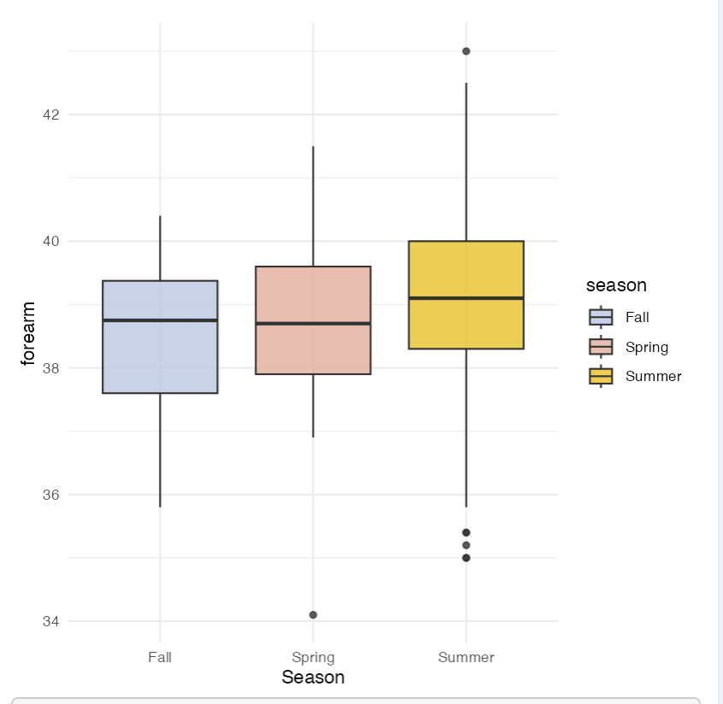
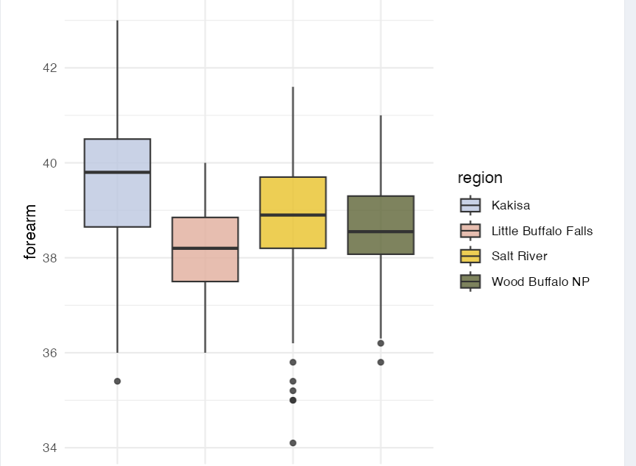
3. Forearm – Seasons & Regions
SIG Difference
SIG Difference
Notes:
Null is no difference; Alternative is there is a difference Season: ANOVA Test. Significant seasonal differences were detected
Regions: ANOVA Test. Significant regional differences were detected

Slide 8
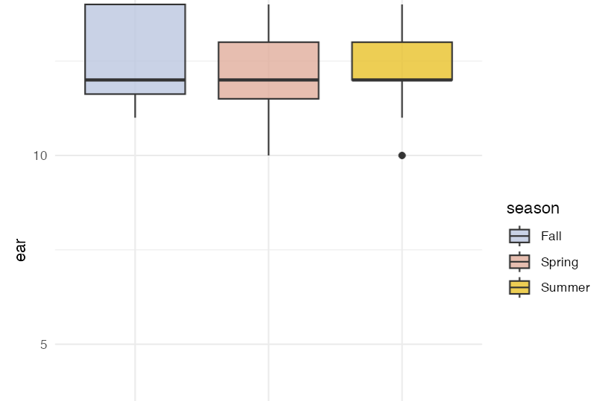
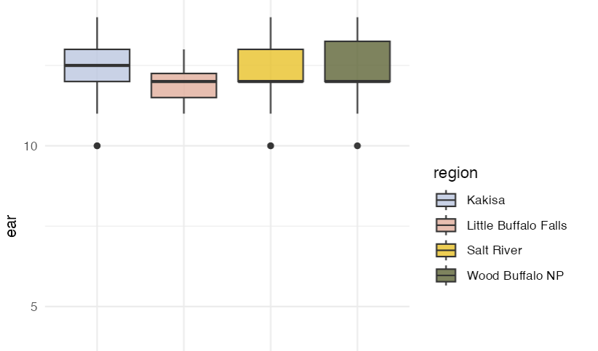
3. Ear length – Seasons & Regions
NO SIG Difference
NO SIG Difference
Notes:
Season: ANOVA Test. No significant seasonal differences were detected
Regions: ANOVA Test. No significant regional differences were detected

Slide 9
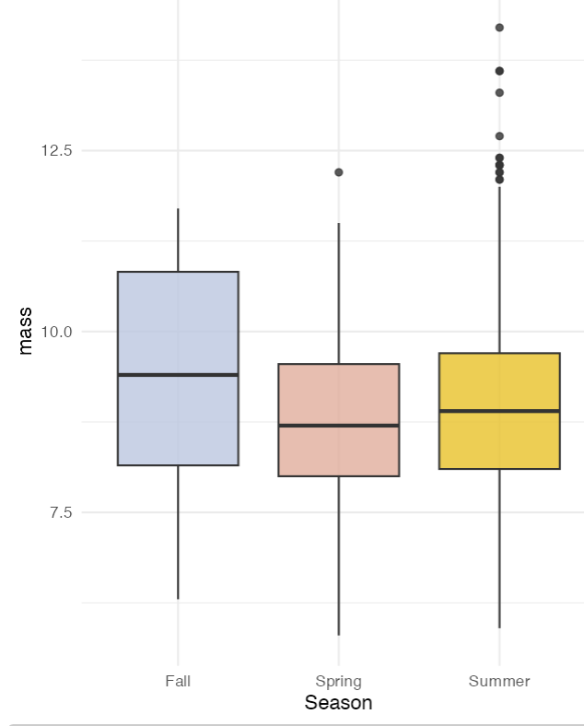
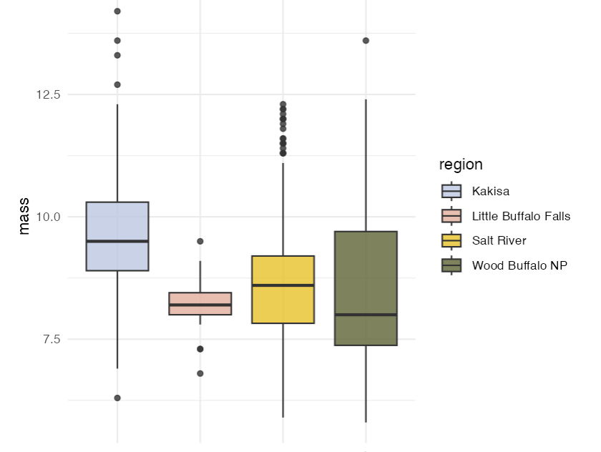
3. Mass– Seasons & Regions
NO SIG Difference
SIG Difference
Notes:
Season: ANOVA Test. No significant seasonal differences were detected
Regions: ANOVA Test. Significant regional differences were detected

Slide 10
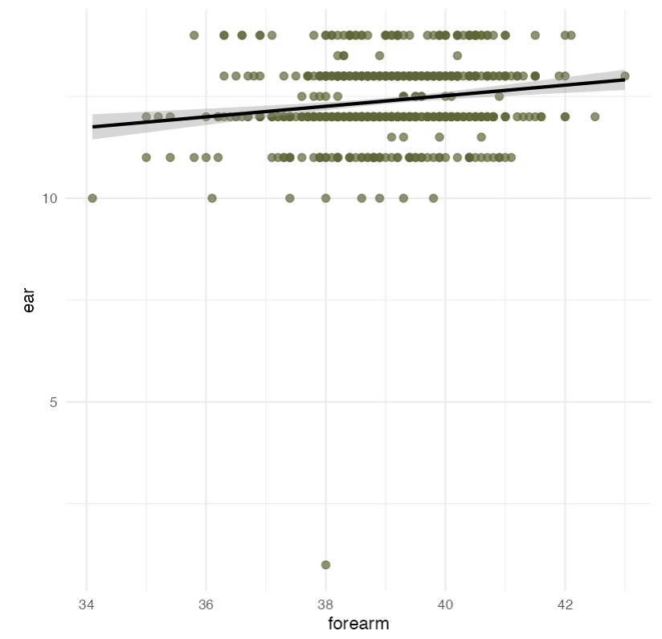
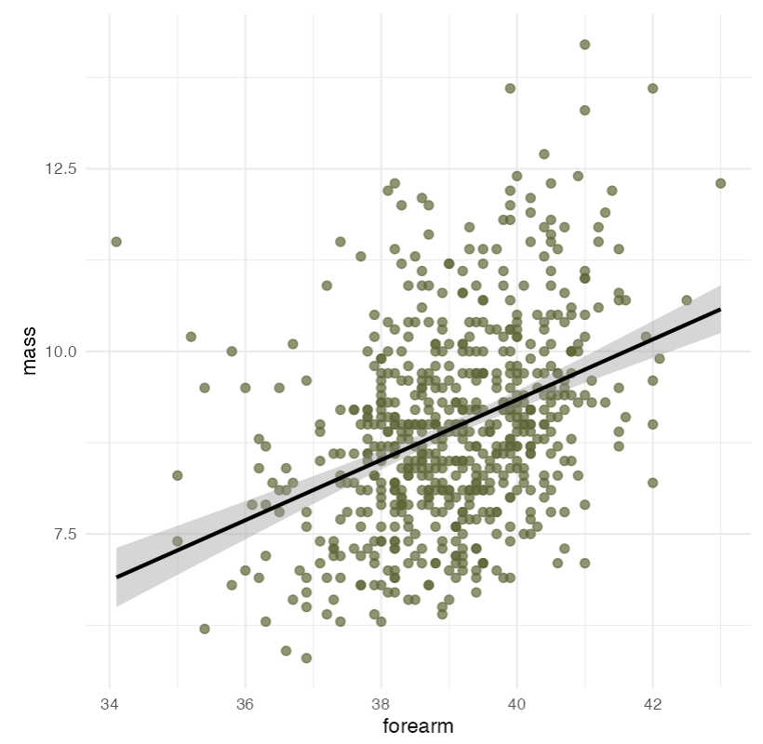
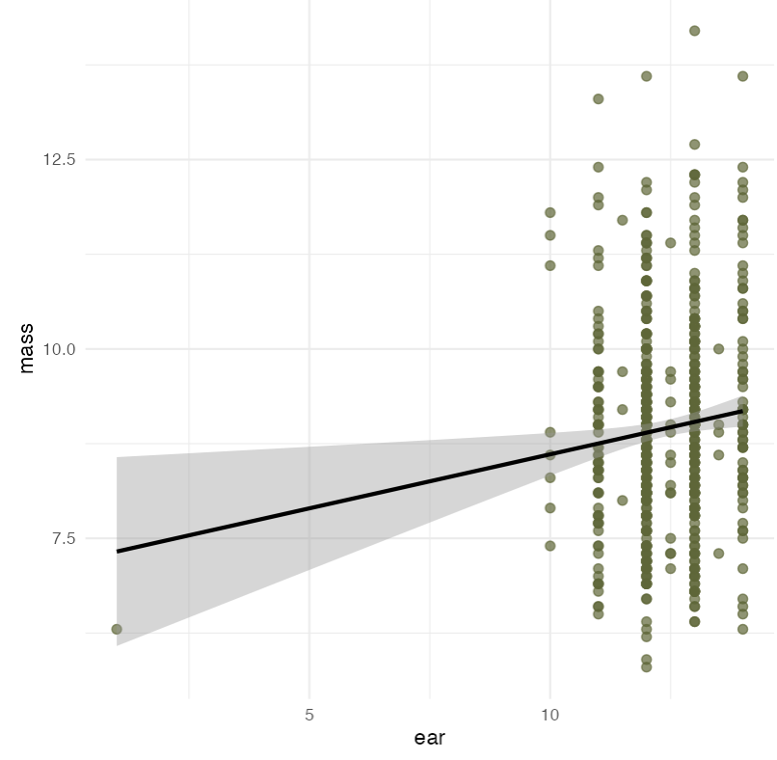
3. Mass & Forearm & Ear Length
Low correlations…
Notes:
Despite the correlation values are low, we still can claim that there are positive relationships among these variables according to the graphs.

Slide 11
Conclusion
1. Site (Types) & Activities
Activity changes across the season
Maternity and Hibernaculum sites show the highest activity
2. Reproductive Status
June - Pregnant; July - Lactating; Aug – Post-lactating (Northern Hemisphere)
 | Season | Region
Forearm Length | ✔ | ✔
Ear Length | ✗ | ✗
Mass | ✗ | ✔

Slide 12
Thanks!
Please keep this slide for attribution

